Slide 1
NEO zadatak – klasifikacija Neo i Non-Neo objekata pomoću mašinskog učenja korišćenjem Random forest algoritma
Predmet: Mašinsko učenje u astronomiji Predmetni nastavnik: prof. dr Anđelka Kovačević Student: Dragoljub Perišić

Slide 2
Cilj ovog Notebooka je kreiranje algoritma koji će automatski klasifikovati mala nebeska tela u 5 kategorija: Amor, Apollo, Atens, Apohele, kao I objekata koji nisu NEO. Za algoritam mašinskog učenja odabran je Random Forest. Ulazni podaci preuzeti su sa sajta: https://minorplanetcenter.net/data Ulazni podaci su pripremljenji za obradu pomoću 4 pomoćna programa.

Slide 3
Iz skupa svih navedenih nebeskih tela odabrano je njih 40123 tako da u svakoj od kategorija bude objekata (ovo je moralo biti urađeno pažljivo jer je polaznih 1.4 miliona tela bilo samo 34 Apohele objekta - koji su svi odabrani u ulazni fajl - input40K.txt). Objekti su podeljeni u dva skupa (trening i test – 20000 u odnosu 80% prema 20%). I drugih 20000 objekata za drugu proveru (sa objektima koji nisu bili korišćeni) tačnosti Random Forest klasifikacije.

Slide 4
Izvršavanje algoritma (sa procenom tačnosti) daje rezultat: "Tačnost Random Forest Klasifikatora: 99.00%". Nakon druge provere (sa drugih 20000 objekata) rezultat je bio: "Tačnost procene je 0.988" što se dobro poklapa sa prvom proverom. Rezultati su predstavljeni i grafički (a vs e - Velika poluosa vs ekscentricitet), a pored tih grafika takođe je prikazan i grafik a vs i (Velika poluosa vs inklinacija)

Slide 5
Od ulaznih podataka za svaki objekat korišćeni su sledeći podaci:
a- Velika poluosa q- Perihel - q=a(1−e) Q -Afel - Q=a(1+e)
Klasifikacija je urađena na osnovu sledećih formula:
Amor = 1.017 < q < 1.3
Apollo = q < 1.017 i a > 1
Atens = a < 1 i Q > 0.983
Apohele = a < 1 i Q < 0.983
NonNEO = q > 1.3
Takođe je korišćenja i filtracija objekata (Velika poluosa manja od 6 AU) jedino iz razloga dobijanja boljeg grafičkog predstavljanja podataka

Slide 6
Definicija SmallBody class
import copy
# definicja SmallBody class
class SmallBody:
def __init__(self, Desn, H, G, Epoch, M, Peri, Node, PEi, PEe, n, PEa, PEq, PEQ):
self.Desn = Desn
self.H = H
self.G = G
self.Epoch = Epoch
self.M = M
self.Peri = Peri
self.Node = Node
self.PEi = PEi
self.PEe = PEe
self.n = n
self.PEa = PEa
self.PEq = PEq
self.PEQ = PEQ

Slide 7
funkcija koja učitava objekte smallbody u listu MyListOfSB
def loadSmallBodies(input_file):
MyListOfSB = []
try:
with open(input_file, 'r') as infile:
header = infile.readline() # preskoči heder
for line in infile:
columns = line.split()
if len(columns) >= 13:
try:
# kreira SmallBody objekat
sb = SmallBody(
Desn=columns[0],
H=float(columns[1]),
G=float(columns[2]),
Epoch=columns[3],
M=float(columns[4]),
Peri=float(columns[5]),
Node=float(columns[6]),
PEi=float(columns[7]),
PEe=float(columns[8]),
n=float(columns[9]),
PEa=float(columns[10]),
PEq=float(columns[11]),
PEQ=float(columns[12])
)
MyListOfSB.append(sb)
except ValueError:
continue # Bitno : preskače linije u slučaju loše konverzije u float
except FileNotFoundError:
print(f"Error: File {input_file} not found.")
return MyListOfSB

Slide 8
Glavni deo
input_file = "input40K.txt“
# polazni fajl je sa sajta MPCORB.DAT sa sajta https://minorplanetcenter.net/data 21.dec.2024.
# fajl input40K.txt sadrži 40123 objekata koji je generisan pomoću pomoćnih programa koji su navedeni
# ispod glavnog programa .. fajl je generisan tako da sadrži tela u svih 5 kategorija
MyListOfSB = loadSmallBodies(input_file)

Slide 9
Kreiranje listi
# Create the five lists
MylistOfAmor = [copy.deepcopy(obj) for obj in MyListOfSB if 1.017 < float(obj.PEq) < 1.3]
MylistOfApollo = [copy.deepcopy(obj) for obj in MyListOfSB if float(obj.PEq) < 1.017 and float(obj.PEa) > 1]
MylistOfAtens = [copy.deepcopy(obj) for obj in MyListOfSB if float(obj.PEa) < 1 and float(obj.PEQ) > 0.983]
MylistOfApohele = [copy.deepcopy(obj) for obj in MyListOfSB if float(obj.PEa) < 1 and float(obj.PEQ) < 0.983]
MylistofNonNEO = [copy.deepcopy(obj) for obj in MyListOfSB if float(obj.PEq) > 1.3]
# Count the objects in each list
countAmor = len(MylistOfAmor)
countApollo = len(MylistOfApollo)
countAtens = len(MylistOfAtens)
countApohele = len(MylistOfApohele)
countNonNEO = len(MylistofNonNEO)
countPocetno=len(MyListOfSB)
countUkupno=countAmor+countApollo+countAtens+countApohele+countNonNEO

Slide 10
Štampanje rezultata
# Print the results
print(f"countAmor: {countAmor}")
print(f"countApollo: {countApollo}")
print(f"countAtens: {countAtens}")
print(f"countApohele: {countApohele}")
print(f"countNonNEO: {countNonNEO}")
print(f"Sum: {countAmor + countApollo + countAtens + countApohele + countNonNEO}")

Slide 11
Podela na trening i drugi test
### ---- dole je ML deo
#### filtriranje
MyListOfSB = [obj for obj in MyListOfSB if float(obj.PEa) < 6]
MylistOfSB lista je podeljenja na dva jednaka dela
half = len(MyListOfSB) // 2
print(f"Ukupno tela: {len(MyListOfSB)}")
MylistOfSBTraining = MyListOfSB[:half] # prva polovina za trening
MylistOfSBTest = MyListOfSB[half:] # druga polovina za test
print(f"Training list size: {len(MylistOfSBTraining)}")
print(f"Test list size: {len(MylistOfSBTest)}")
Ukupno tela: 39940
print(f"Training list size: {len(MylistOfSBTraining)}")
print(f"Test list size: {len(MylistOfSBTest)}")
Training list size: 19970 Test list size: 19970

Slide 12
podela na trening i test svake liste ponaosob
half = len(MylistOfAmor) // 2
print(f"Ukupno tela: {len(MylistOfAmor)}")
MylistOfAmorTraining = MylistOfAmor[:half]
MylistOfAmorTest = MylistOfAmor[half:]
print(f"Training list size: {len(MylistOfAmorTraining)}")
print(f"Test list size: {len(MylistOfAmorTest)}")
Ukupno tela: 13128 Training list size: 6564 Test list size: 6564
half = len(MylistOfApollo) // 2
print(f"Ukupno tela: {len(MylistOfApollo)}")
MylistOfApolloTraining = MylistOfApollo[:half]
MylistOfApolloTest = MylistOfApollo[half:]
print(f"Training list size: {len(MylistOfApolloTraining)}")
print(f"Test list size: {len(MylistOfApolloTest)}")
Ukupno tela: 20905 Training list size: 10452 Test list size: 10453

Slide 13
half = len(MylistOfAtens) // 2
print(f"Ukupno tela: {len(MylistOfAtens)}")
MylistOfAtensTraining = MylistOfAtens[:half]
MylistOfAtensTest = MylistOfAtens[half:]
print(f"Training list size: {len(MylistOfAtensTraining)}")
print(f"Test list size: {len(MylistOfAtensTest)}")
Ukupno tela: 2920 Training list size: 1460 Test list size: 1460
half = len(MylistOfApohele) // 2
print(f"Ukupno tela: {len(MylistOfApohele)}")
MylistOfApoheleTraining = MylistOfApohele[:half]
MylistOfApoheleTest = MylistOfApohele[half:]
print(f"Training list size: {len(MylistOfApoheleTraining)}")
print(f"Test list size: {len(MylistOfApoheleTest)}")
Ukupno tela: 34 Training list size: 17 Test list size: 17

Slide 14
half = len(MylistofNonNEO) // 2
print(f"Ukupno tela: {len(MylistofNonNEO)}")
MylistofNonNEOTraining = MylistofNonNEO[:half]
MylistofNonNEOTest = MylistofNonNEO[half:]
print(f"Training list size: {len(MylistofNonNEOTraining)}")
print(f"Test list size: {len(MylistofNonNEOTest)}")
Ukupno tela: 2964 Training list size: 1482 Test list size: 1482

Slide 15
granica =10 ### 10 astronomskih jedinica za veliku poluosu
MylistOfAmorTraining = [obj for obj in MylistOfAmorTraining if float(obj.PEa) < granica]MylistOfAmorTest = [obj for obj in MylistOfAmorTest if float(obj.PEa) < granica]
MylistOfApolloTraining = [obj for obj in MylistOfApolloTraining if float(obj.PEa) < granica]MylistOfApolloTest = [obj for obj in MylistOfApolloTest if float(obj.PEa) < granica]
MylistOfAtensTraining = [obj for obj in MylistOfAtensTraining if float(obj.PEa) < granica]MylistOfAtensTest = [obj for obj in MylistOfAtensTest if float(obj.PEa) < granica]
MylistOfApoheleTraining = [obj for obj in MylistOfApoheleTraining if float(obj.PEa) < granica]MylistOfApoheleTest = [obj for obj in MylistOfApoheleTest if float(obj.PEa) < granica]
MylistofNonNEOTraining = [obj for obj in MylistofNonNEOTraining if float(obj.PEa) < granica]MylistofNonNEOTest = [obj for obj in MylistofNonNEOTest if float(obj.PEa) < granica]

Slide 16
Velika poluosa vs inklinacija (a vs i )
import matplotlib.pyplot as plt
# Convert the data into arrays
xs = [obj.PEa for obj in MyListOfSB if obj.PEa is not None]
resX = [float(ele) for ele in xs]
ys = [obj.PEi for obj in MyListOfSB if obj.PEi is not None]
resY = [float(ele) for ele in ys]
# minimum i maximum za x and y
min_x, max_x = min(resX), max(resX)
min_y, max_y = min(resY), max(resY)
print(f"X range: {min_x} to {max_x}")
print(f"Y range: {min_y} to {max_y}")
# Adjust the scatter plot size dynamically based on the range
marker_size = max(1, 100 / len(resX)) # Dynamic marker size; smaller if too many points

Slide 17
Labele i naslov
# Labele i naslov
plt.xlabel("a")
plt.ylabel("i")
plt.title("a vs i")
plt.grid(True)
# crtanje tačaka
plt.scatter(resX, resY, s=marker_size, color='blue', label='Data points')
# legenda
plt.legend()
# granice za ose na osnovu Set data ranges
plt.xlim(min_x - 0.1 * (max_x - min_x), max_x + 0.1 * (max_x - min_x))
plt.ylim(min_y - 0.1 * (max_y - min_y), max_y + 0.1 * (max_y - min_y))
# crta plot
plt.show()

Slide 18
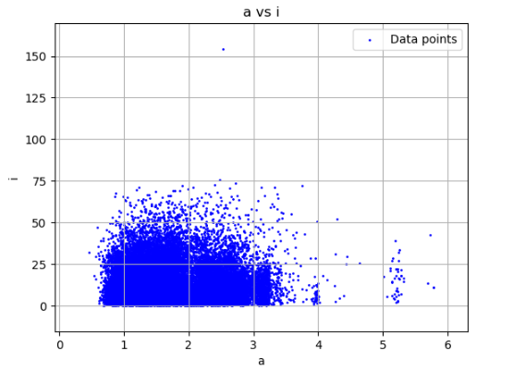
Grafik : veza između velike poluose i inklinacije za NEO objekte

Slide 19
Velika poluosa vs ekscentricitet (a vs e)
import matplotlib.pyplot as plt300
xs = [obj.PEa for obj in MyListOfSB]
resX = [float(ele) for ele in xs]
ys = [obj.PEe for obj in MyListOfSB]
resY = [float(ele) for ele in ys]
plt300.xlabel("a")
plt300.ylabel("e")
plt300.title(" a vs e")
plt300.legend()
# crtanje tačaka
plt300.scatter(resX, resY, s=3, color='blue', label='Data points')
# prikaži plot
plt300.grid(True)
plt300.show()

Slide 20
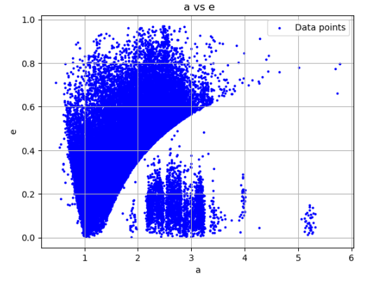
Grafik – velika poluosa vs ekscentricitet za NEO objekte

Slide 21
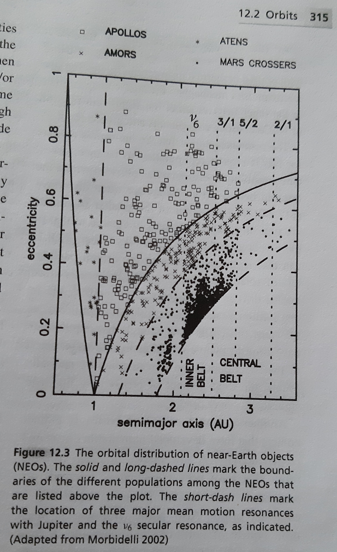
Grafik – velika poluosa vs ekscentricitet za NEO objekte – originalna slika

Slide 22
print ("Pocetni broj NEO tela: "+ str(countPocetno))
print ("Ukupno posle filtracije (a<4 AU) ): "+ str(countUkupno))
Pocetni broj NEO tela: 39940
Ukupno posle filtracije (a<4 AU) ): 39951
countAmor: count 13128
countApollo: count 20905
countAtens: count 2920
countApohele: count 34
MyListofNonNEO: count 2964
countAmorTest: count 6561
countApolloTest: count 10453
countAtensTest: count 1460
countApoheleTest: count 17
MyListofNonNEOTest: count 1481

Slide 23
velika poluosa vs ekscentricitet za svih 5 kategorija
import matplotlib.pyplot as plt300
# konverzija lista u niz
xs1 = [obj.PEa for obj in MylistOfAmorTraining]
resX1 = [float(ele) for ele in xs1]
ys1 = [obj.PEe for obj in MylistOfAmorTraining]
resY1 = [float(ele) for ele in ys1]
xs2 = [obj.PEa for obj in MylistOfApolloTraining]
resX2 = [float(ele) for ele in xs2]
ys2 = [obj.PEe for obj in MylistOfApolloTraining]
resY2 = [float(ele) for ele in ys2]
xs3 = [obj.PEa for obj in MylistOfAtensTraining]
resX3 = [float(ele) for ele in xs3]
ys3 = [obj.PEe for obj in MylistOfAtensTraining]
resY3 = [float(ele) for ele in ys3]
xs4 = [obj.PEa for obj in MylistOfApoheleTraining]
resX4 = [float(ele) for ele in xs4]
ys4 = [obj.PEe for obj in MylistOfApoheleTraining]
resY4 = [float(ele) for ele in ys4]
xs5 = [obj.PEa for obj in MylistofNonNEOTraining]
resX5 = [float(ele) for ele in xs5]
ys5 = [obj.PEe for obj in MylistofNonNEOTraining]
resY5 = [float(ele) for ele in ys5]

Slide 24
plt300.xlabel("a")
plt300.ylabel("e")
plt300.title(" a vs e")
plt300.legend()
# crtanje tačaka
plt300.scatter(resX1, resY1, s=2 ,c='red', label='Amor')
plt300.scatter(resX2, resY2, s=2 ,c='blue', label='Apollo')
plt300.scatter(resX3, resY3, s=2 ,c='green', label='Atens')
plt300.scatter(resX4, resY4, s=2 ,c='black', label='Apohele')
plt300.scatter(resX5, resY5, s=2 ,c='yellow', label='NonNEO')
plt.legend()
plt300.grid(True)
plt300.show()

Slide 25
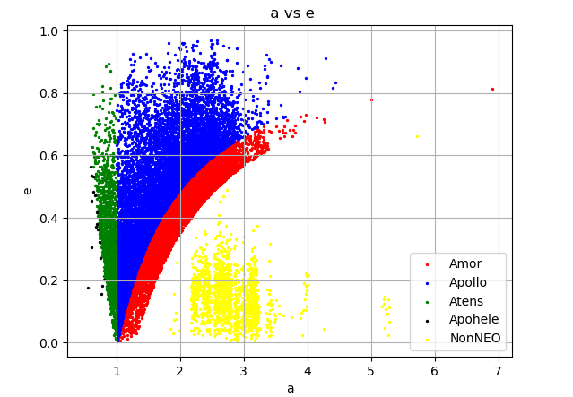
Pet kategorija NEO objekata – provera podele

Slide 26
Random forest algoritam - Početak
import numpy as np
import matplotlib.pyplot as plt
from sklearn.ensemble import RandomForestClassifier
from sklearn.model_selection import train_test_split
from sklearn.metrics import accuracy_score
Priprema lista
list1 = [(float(obj.PEa), float(obj.PEe)) for obj in MylistOfAmorTraining]
list2 = [(float(obj.PEa), float(obj.PEe)) for obj in MylistOfApolloTraining]
list3 = [(float(obj.PEa), float(obj.PEe)) for obj in MylistOfAtensTraining]
list4 = [(float(obj.PEa), float(obj.PEe)) for obj in MylistOfApoheleTraining]
list5 = [(float(obj.PEa), float(obj.PEe)) for obj in MylistofNonNEOTraining]

Slide 27
Random forest – glavni deo
# Combine all data into one dataset with labels
X = np.array(list1 + list2 + list3 + list4 + list5) # Features
y = np.array([0] * len(list1) + [1] * len(list2) + [2] * len(list3) + [3] * len(list4)+ [4] * len(list5)) # Labels
# Split data into training and testing sets
X_train, X_test, y_train, y_test = train_test_split(X, y, test_size=0.2, random_state=42)
# Train a Random Forest Classifier
clf = RandomForestClassifier(n_estimators=100, random_state=42)
clf.fit(X_train, y_train)
# Predict on the test set
y_pred = clf.predict(X_test)
# Calculate accuracy
accuracy = accuracy_score(y_test, y_pred)
print(f"Tačnost Random Forest Klasifikatora: {accuracy * 100:.2f}%")
# Plot decision boundaries and clusters
plt.figure(figsize=(12, 8))
# Create a mesh grid for decision boundary visualization
x_min, x_max = X[:, 0].min() , X[:, 0].max()
y_min, y_max = X[:, 1].min() , X[:, 1].max()
xx, yy = np.meshgrid(np.arange(x_min, x_max, 0.1),
np.arange(y_min, y_max, 0.1))

Slide 28
Random forest – glavni deo
# Predict for each point in the mesh grid
Z = clf.predict(np.c_[xx.ravel(), yy.ravel()])
Z = Z.reshape(xx.shape)
#### Plot decision boundaries
plt.contourf(xx, yy, Z, alpha=0.3, cmap=plt.cm.Paired)
###############plt.contour(xx, yy, Z, colors='black', linewidths=3) # Black borders for cluster boundaries
# Scatter plot for each cluster
labels = ['Amor', 'Apollo', 'Atens', 'Apohele', 'NonNEO']
colors = ['red', 'blue', 'green', 'purple', 'yellow']
for cluster in range(5):
plt.scatter(
X[y == cluster, 0],
X[y == cluster, 1],
label=f"{labels[cluster]}",
alpha=0.6,
color=colors[cluster]
)
plt.title("Scatter Plot of Classified Clusters with Decision Boundaries")
plt.xlabel("a")
plt.ylabel("e")
plt.legend()
plt.grid(True)
plt.show()
Tačnost Random Forest Klasifikatora: 99.00%

Slide 29
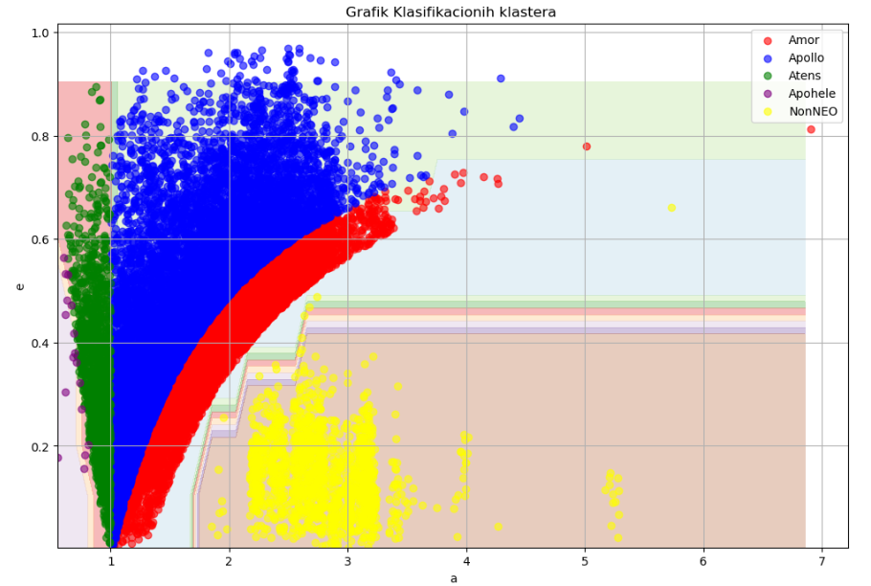
Random forest – rezultat – 5 klasa

Slide 30
Druga provera preciznosti random forest algoritma
points = np.array([(float(obj.PEa), float(obj.PEe)) for obj in MylistOfAmorTest])
predicted_clusters = clf.predict(points)
count_cluster_0 = np.sum(predicted_clusters == 0)
print(f"Broj tačaka u klasteru 0: {count_cluster_0}")
print("Length of MylistOfAmorTest is " + str(len(MylistOfAmorTest)))
Broj tačaka u klasteru 0: 6423 Length of MylistOfAmorTest is 6561
points = np.array([(float(obj.PEa), float(obj.PEe)) for obj in MylistOfApolloTest])
predicted_clusters = clf.predict(points)
count_cluster_1 = np.sum(predicted_clusters == 1)
print(f"Broj tačaka u klasteru 1: {count_cluster_1}")
print("Length of MylistOfApolloTest is " + str(len(MylistOfApolloTest)))
Broj tačaka u klasteru 1: 10369 Length of MylistOfApolloTest is 10453

Slide 31
points = np.array([(float(obj.PEa), float(obj.PEe)) for obj in MylistOfAtensTest])
predicted_clusters = clf.predict(points)
count_cluster_2 = np.sum(predicted_clusters == 2)
print(f"Broj tačaka u klasteru 2: {count_cluster_2}")
print("Length of MylistOfAtensTest is " + str(len(MylistOfAtensTest)))
Broj tačaka u klasteru 2: 1459 Length of MylistOfAtensTest is 1460
points = np.array([(float(obj.PEa), float(obj.PEe)) for obj in MylistOfApoheleTest])
predicted_clusters = clf.predict(points)
count_cluster_3 = np.sum(predicted_clusters == 3)
print(f"Broj tačaka u klasteru 3: {count_cluster_3}")
print("Length of MylistOfApoheleTest is " + str(len(MylistOfApoheleTest)))
Broj tačaka u klasteru 3: 10 Length of MylistOfApoheleTest is 17

Slide 32
points = np.array([(float(obj.PEa), float(obj.PEe)) for obj in MylistofNonNEOTest])
predicted_clusters = clf.predict(points)
count_cluster_4 = np.sum(predicted_clusters == 4)
print(f"Broj tačaka u klasteru 4: {count_cluster_4}")
print("Length of MylistofNonNEOTest is " + str(len(MylistofNonNEOTest)))
Broj tačaka u klasteru 4: 1476 Length of MylistofNonNEOTest is 1481
sumForProcena = count_cluster_0 + count_cluster_1 + count_cluster_2 +count_cluster_3 + count_cluster_4
print("Ukupni broj Tela koji je dobro određen " + str(sumForProcena) )
print("Ukupan broj tela za testiranje je " + str(len(MylistOfSBTest)))
print (" Tačnost procene je "+ str (float (sumForProcena /len(MylistOfSBTest)) ) )
Ukupni broj Tela koji je dobro određen 19737 Ukupan broj tela za testiranje je 19970
Tačnost procene je 0.9883324987481222

Slide 33
Hvala na pažnji

